Slide 1
Lecture 4.2. Central Limit Theorem

Slide 2
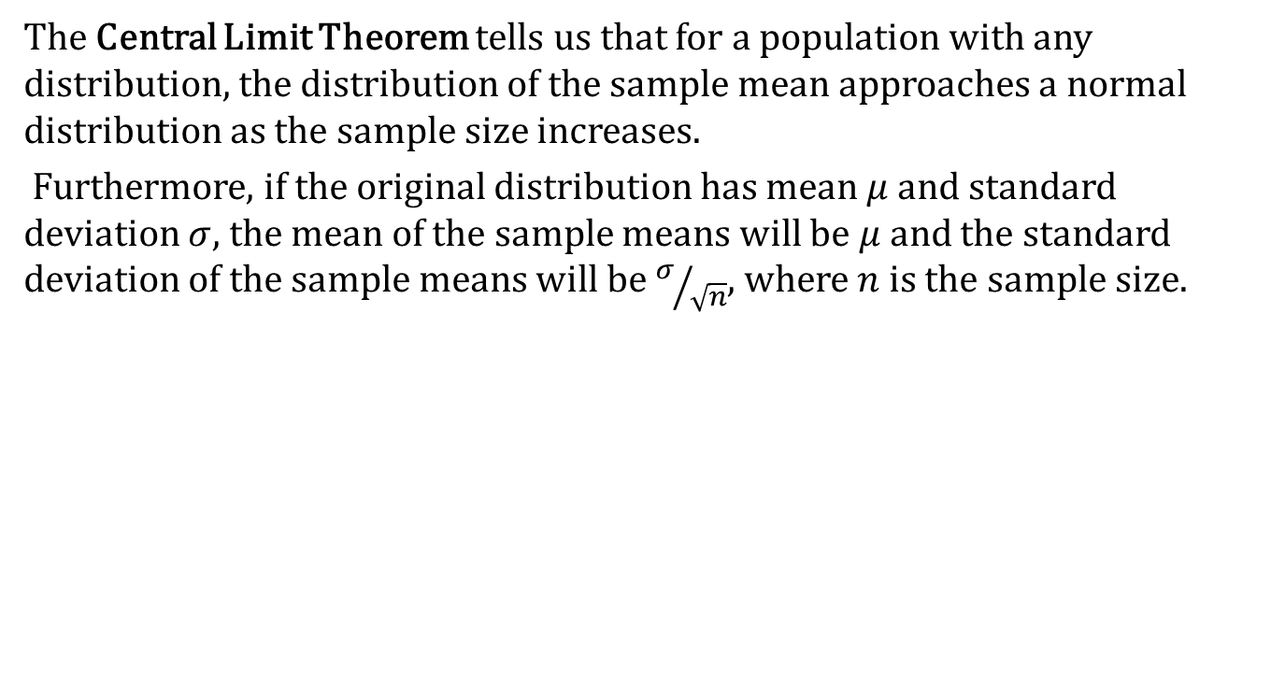
The Central Limit Theorem
The Central Limit Theorem tells us that for a population with any distribution, the distribution of the sample mean approaches a normal distribution as the sample size increases.
Furthermore, if the original distribution has mean $μ$ and standard deviation $σ$, the mean of the sample means will be $μ$ and the standard deviation of the sample means will be $σ/{\sqrt{n}}$, where $n$ is the sample size.

Slide 3
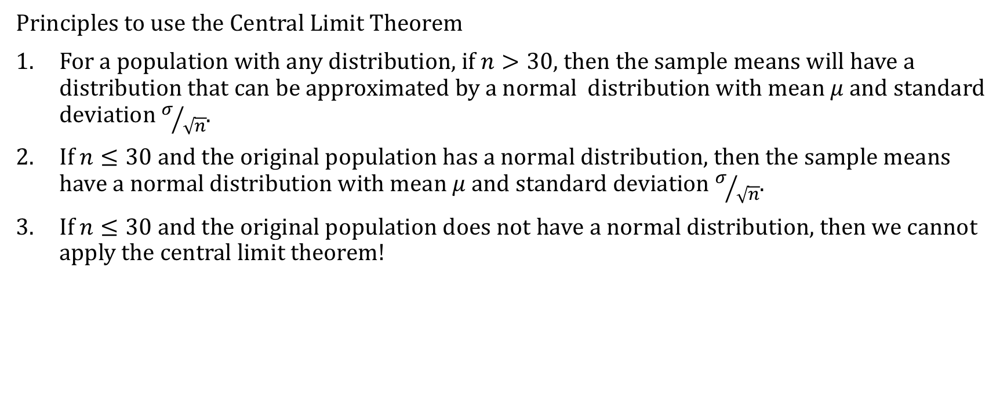
The Central Limit Theorem
Principles to use the Central Limit Theorem
For a population with any distribution, if $n>30$, then the sample means will have a distribution that can be approximated by a normal distribution with mean $μ$ and standard deviation $σ/{\sqrt{n}}$.
If $n≤30$ and the original population has a normal distribution, then the sample means have a normal distribution with mean $μ$ and standard deviation $σ/{\sqrt{n}}$.
If $n≤30$ and the original population does not have a normal distribution, then we cannot apply the central limit theorem!

Slide 4
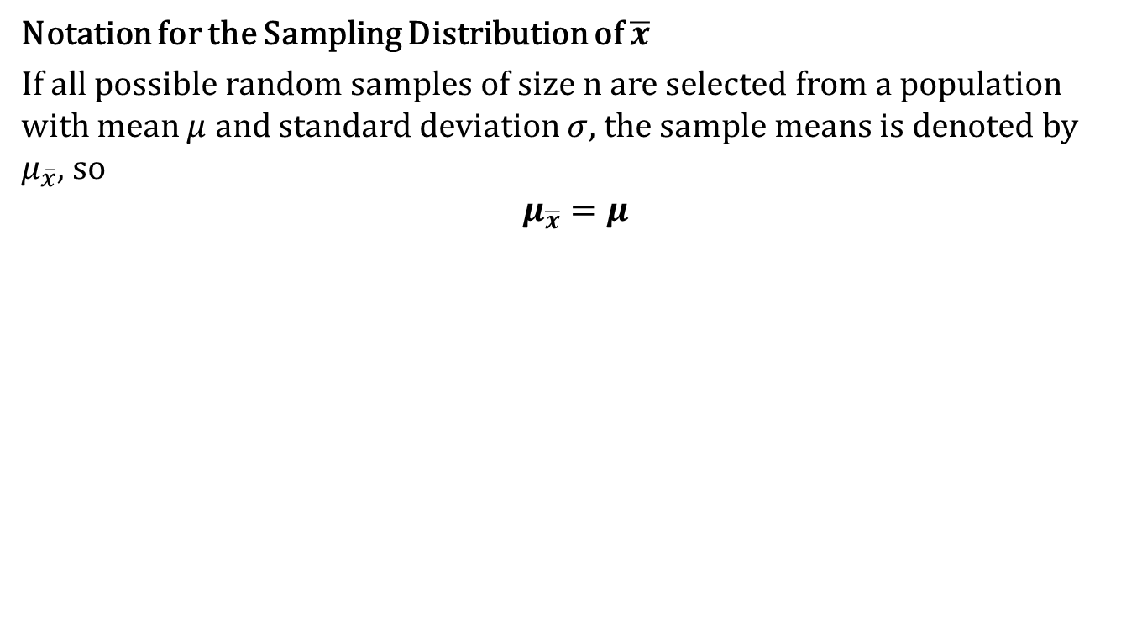
The Central Limit Theorem
Notation for the Sampling Distribution of $\overline{x}$
If all possible random samples of size n are selected from a population with mean $μ$ and standard deviation $σ$, the sample means is denoted by $μ_{\overline{x}}$, so
$$μ_{\overline{x}}=μ$$

Slide 5
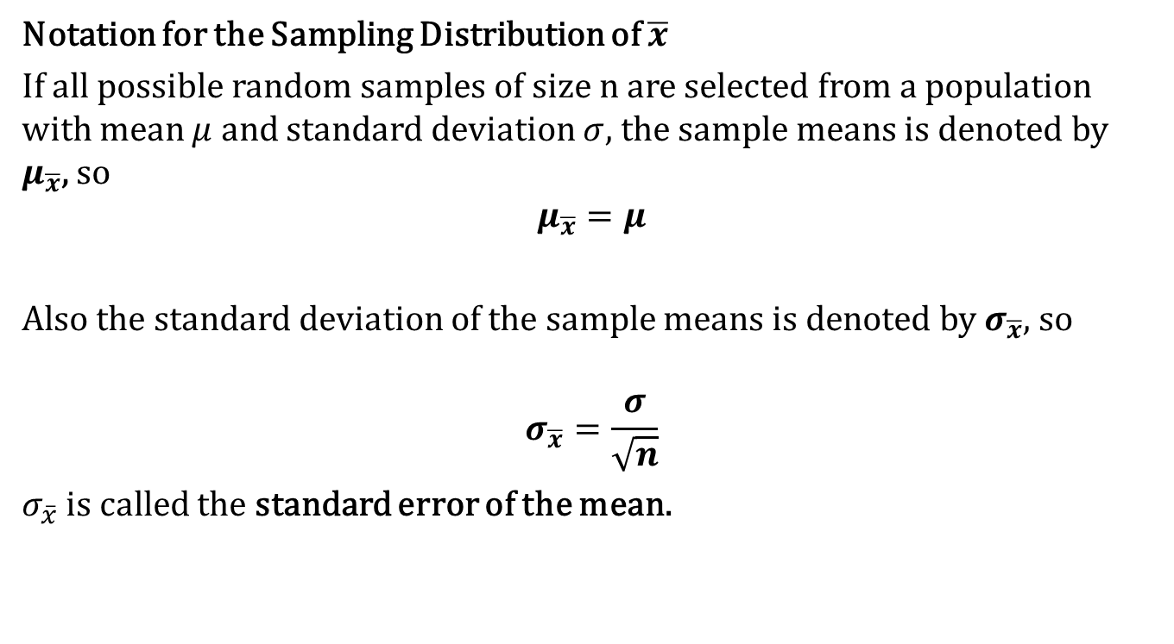
The Central Limit Theorem
Notation for the Sampling Distribution of $\overline{x}$
If all possible random samples of size n are selected from a population with mean $μ$ and standard deviation $σ$, the sample means is denoted by $μ_{\overline{x}}$, so
$$μ_{\overline{x}}=μ$$
Also the standard deviation of the sample means is denoted by $σ_{\overline{x}}$, so
$$σ_{\overline{x}}=\frac{σ}{\sqrt{n}}$$
$σ_{\overline{x}}$ is called the standard error of the mean.

Slide 6
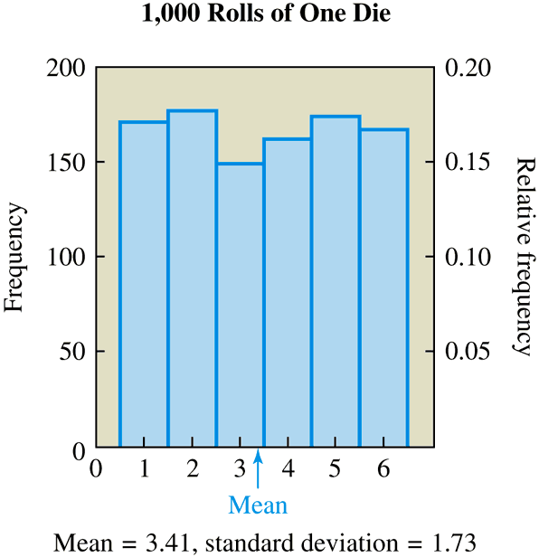
Visualizing the Central Limit Theorem Using Dice
Suppose we roll one die 1,000 times and record the outcome of each roll, which can be the number 1, 2, 3, 4, 5, or 6.

Slide 7
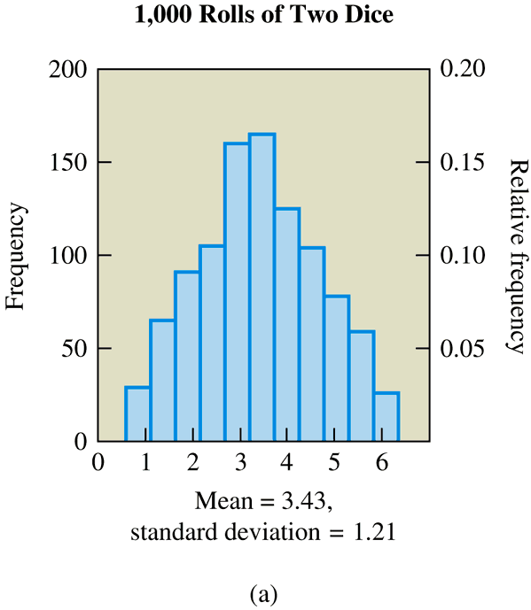
Visualizing the Central Limit Theorem Using Dice
Now suppose we roll two dice 1,000 times and record the mean of the two numbers that appear on each roll. To find the mean for a single roll, we add the two numbers and divide by 2.

Slide 8
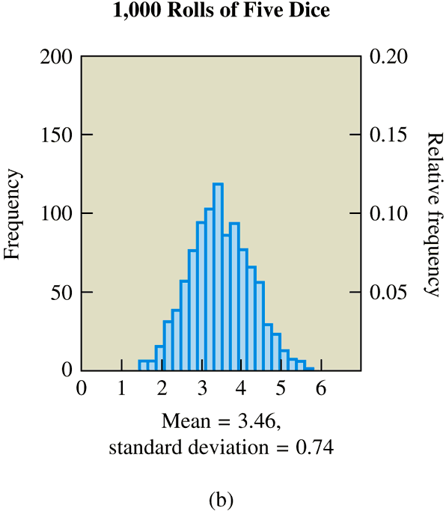
Visualizing the Central Limit Theorem Using Dice
Suppose we roll five dice 1,000 times and record the mean of the five numbers on each roll.

Slide 9
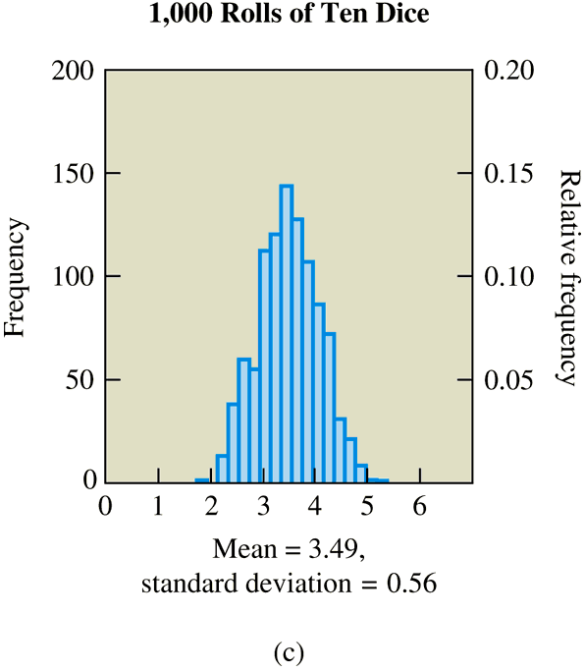
Visualizing the Central Limit Theorem Using Dice
Now we will further increase the number of dice to ten on each of 1,000 rolls.
http://www.stat.sc.edu/~west/javahtml/CLT.html

Slide 10
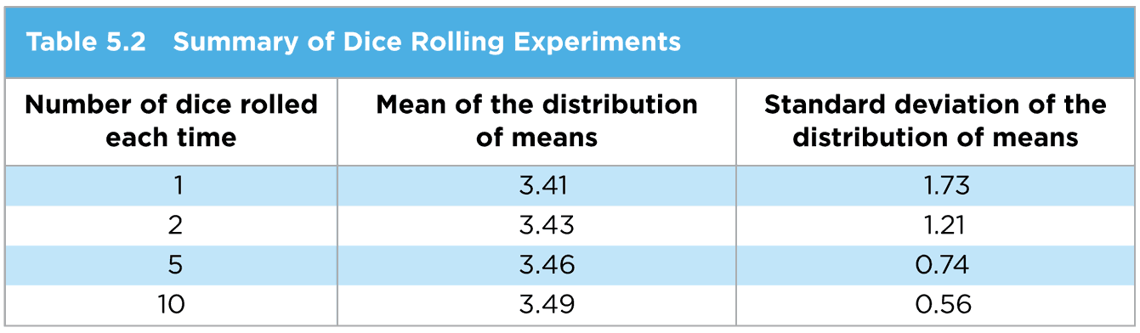
Visualizing the Central Limit Theorem Using Dice
What do you notice about the shape of the distribution as the sample size increases?
It approximates a normal distribution
What do you notice about the mean of the distribution of sample means as the sample size increases in comparison to the true mean of the population (3.5)?
It approaches the population mean
What do you notice about the standard deviation of the distribution of means as the sample size increases?
It gets smaller representing a lower variation

Slide 11
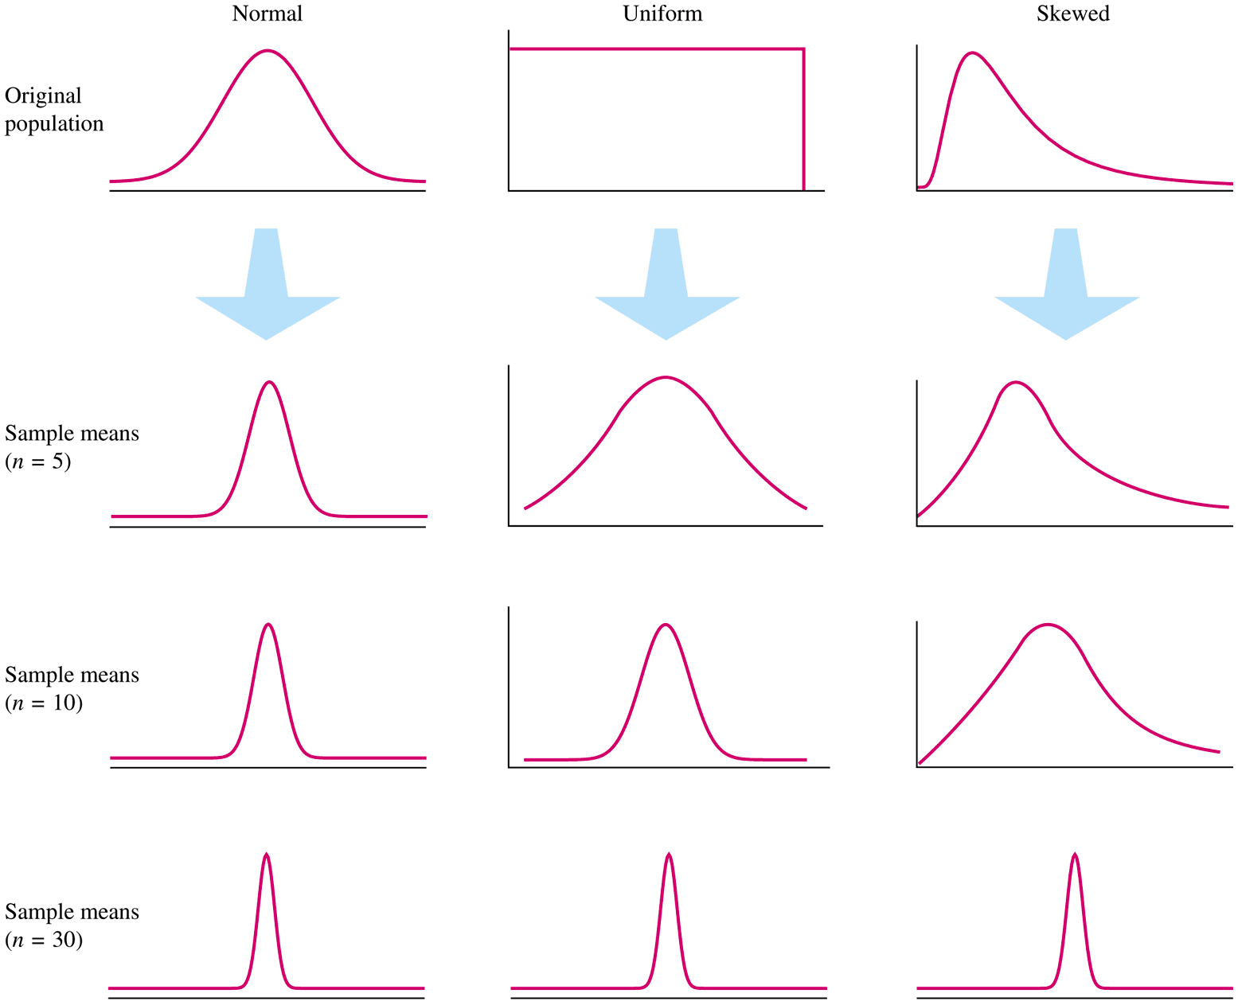
Shapes of Distributions as Sample Size Increases

Slide 12
Implication of the Central Limit Theorem
Inferences about probabilities of events
based on the sample mean can use a
normal approximation even if the data
themselves are not drawn from a normal
population.

Slide 13
Example 1 ~ Predicting Test Scores
You are a middle school principal and your 100 eighth-graders are about to take a national standardized test. The test is designed so that the mean score is μ = 400 with a standard deviation of σ = 70. Assume the scores are normally distributed.
a. What is the likelihood that one of your eighth-graders,
selected at random, will score below 375 on the exam?
Since the distribution is normal, we can just use z-scores
to determine the percentage for one student
According to the table, a z-score of -0.36 corresponds to about 36% which means that about 36% of all students can be expected to score below 375, thus there is a 36% chance that a randomly selected student will score below 375

Slide 14
Example 1 ~ Predicting Test Scores
You are a middle school principal and your 100 eighth-graders are about to take a national standardized test. The test is designed so that the mean score is μ = 400 with a standard deviation of σ = 70. Assume the scores are normally distributed.
b. Your performance as a principal depends on how well your entire group of
eighth-graders scores on the exam. What is the likelihood that your group of
100 eighth-graders will have a mean score below 375?
According to the C.L.T. if we take random groups of say 100 students and study their
means, then the means distribution will approach normal. Hence, the μ = 400 and its
standard deviation is σ/√n = 70/√100 = 70/10 = 7 according to the C.L.T.
Therefore, the z-score for a mean of 375 with a standard deviation of 7 is:
The percent that corresponds to a z-score of -3.57 is less than .01%, which means
that fewer than .01% of all samples of 100 students will have a mean score of 375. In
other words, 1 in 5000 samples of 100 students will have a mean score of 375.

Slide 15
Example 2 ~ Poisson Sample
797 794 817 813 817 793 762 719 804 811
837 804 790 796 807 801 805 811 835 787
800 771 794 805 797 724 820 601 817 801
798 797 788 802 792 779 803 807 789 787
794 792 786 808 808 844 790 763 784 739
805 817 804 807 800 785 796 789 842 829
The sample of 60 operators from text exercise 2.22 appears above. Suppose it is claimed that the population that generated these data is Poisson with mean 800 (as assumed earlier). How likely is it to have observed these data if the claim is true?
The sample mean is 793.23. The assumed population standard error of the mean, as we saw earlier, is sqr(800/60) = 3.65. If the mean really were 800 (and the standard deviation were 28.28), then the probability of observing a sample mean this low would be
P[z < (793.23 – 800)/3.65] = P[z < -1.855] = .0317981.
This is fairly small. (Less than the usual 5% considered reasonable.) This might cast some doubt on the claim that the true mean is still 800.

Slide 16
Example 2 ~ Poisson Sample

